Slide 1

A Conversation about Responsibilities

Slide 2
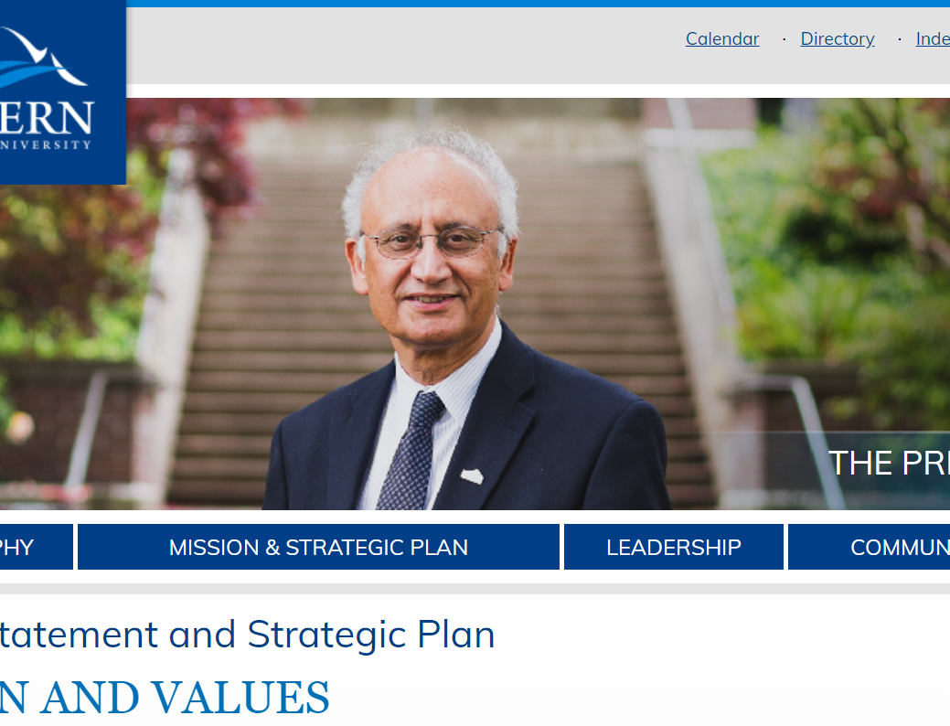

Our Charge –
Commitment to student success, critical thought, creativity, and sustainability
Commitment to equity and justice, and respect for the rights and dignity of others
Pursuit of excellence, in an environment characterized by principles of shared governance, academic freedom and effective engagement
Integrity, responsibility and accountability in all our work

Slide 3
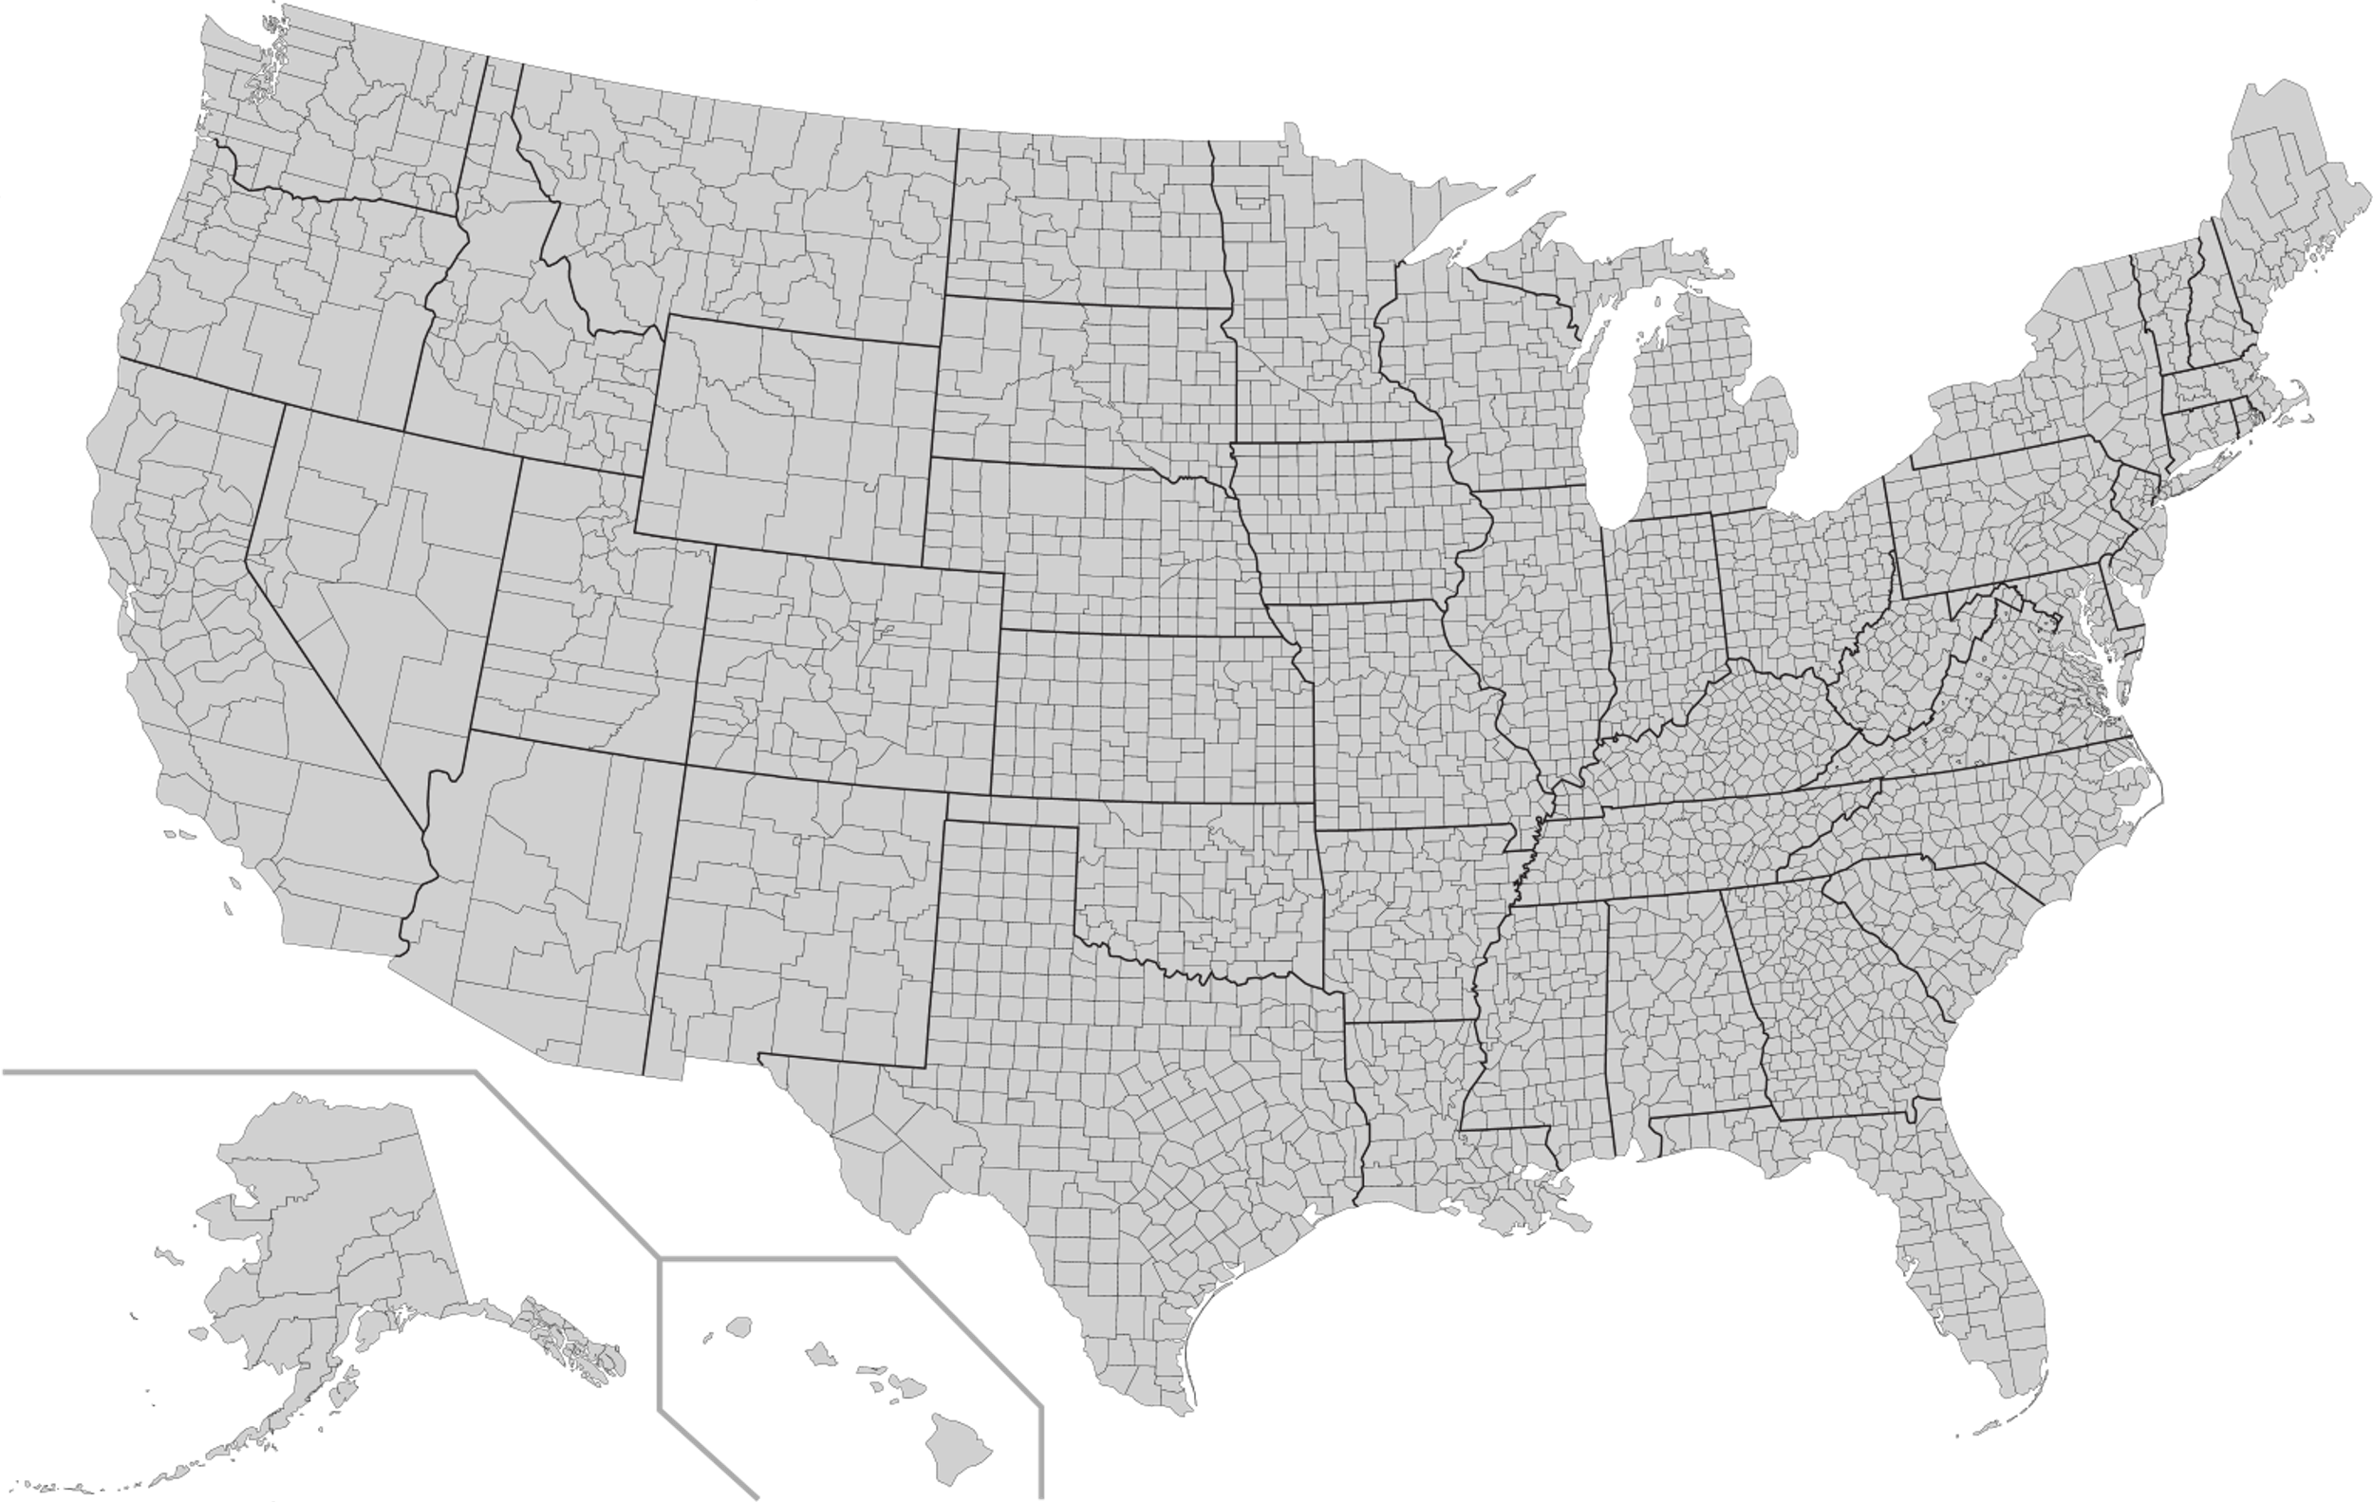
What Do We Know
How many counties in the US?
3,242
How many degree granting institutions in the US?
4,298

Slide 5
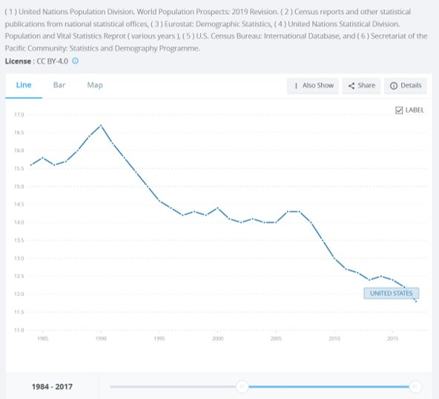

Head Winds
Demographics
Notes:
Births Per 1000 People

Slide 6
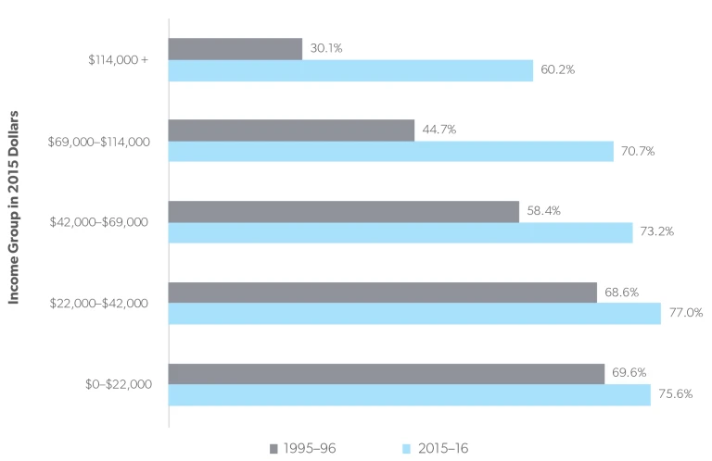

Head Winds
Student Loans
Notes:
This is a very specific data set:
https://www.marketplace.org/2019/12/04/more-students-from-higher-income-families-taking-out-student-loans/?utm_campaign=Marketplace+Midday_Newsletter_20191204_120823&utm_medium=email&utm_source=sfmc_Newsletter&utm_content=Student%20loan%20uptake%20uptick

Slide 7
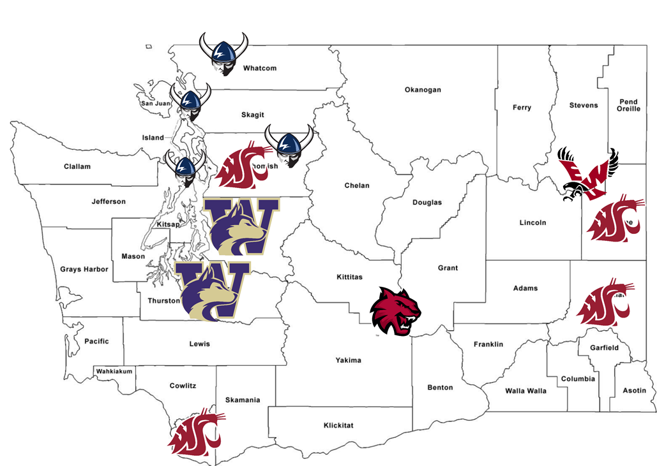
Head Winds
Existing Participants
Notes:
Everyone misses Evergreen

Slide 8
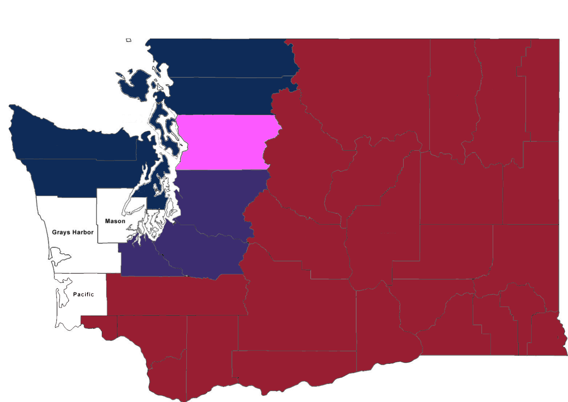
Head Winds
A Possible Future
Notes:
Blue – Western, expansion into Clallam, Jefferson, Kitsap & Island counties from Whatcom
Pink – Western share’s an Everett site with WSU
Red – WSU take over of EWU & CWU
Purple – UW staying put with dense urban

Slide 9
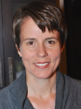
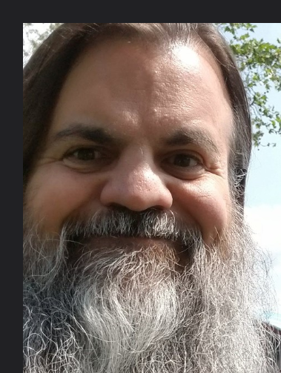
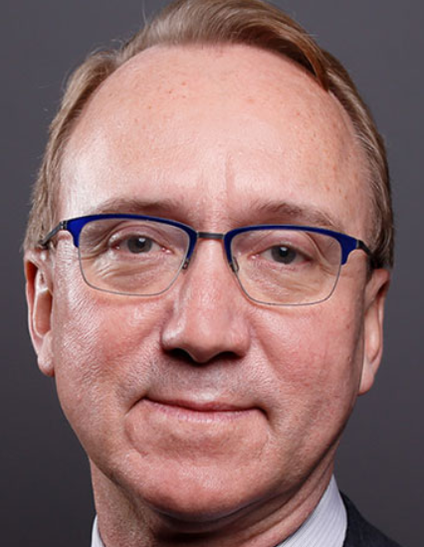
Sea Change Talk
Tracy’s Points
Mergers are challenging, and its not a common skill set, but there are positives
Participated a Merger
Opening the door to underserved communities doesn’t dilute the “brand”
Bryan’s Points
Three Outcomes: Survival, Merger and Closure
The US Education system was not prepared for demographic shifts and demagogues
Brad’s Points
Everyone’s preaching growth, and that’s not realistic
Going Broad and driving down the cost per student
Tracy – CIO Boston University
Bryan – Futurist & Fellow at George Town
Brad – CIO of Indiana University
Notes:
Moody's
Moody's expects private universities to outperform public universities. At least 15% of universities will be forced to cut costs in response to stagnant or weak revenue growth
https://www.moodys.com/research/Moodys-US-higher-education-sector-outlook-revised-to-negative-as--PR_376587
Deloitte
Rising expenses—notably caused by increasing administrative, infrastructural, technology, and student-related costs—may outpace the industry’s ability to adjust tuition, forcing institutions to rethink the way they operate.
https://www2.deloitte.com/us/en/pages/public-sector/articles/higher-education-industry-outlook.html

Slide 10
Wheelock Transition Program
Project Roadmap (as of 06/22/18)
2017
2018
2019
Nov
Dec
Jan
Feb
Mar
Apr
May
Jun
Jul
Aug
Sep
Oct
Nov
Dec
Jan
Feb
Transition Operations Support
Create Academic Mapping
Enrollment Agreement
Summer Orientation
Jenzabar Student System Shutdown
Create Semester Record/Class Yr.
Course Registration
Ad Astra Shutdown
Fall ‘18 Semester Start
Provost Letter to Wheelock Students
IQCatalog/IQCurriculum Shutdown
Transition Advising Day
Housing Lottery Open
Housing Deposit
Wheelock Transition Budget Due
ENSA-Wheelock Student Record Operational Support
Wheelock IT Support Services Transition
Vendor Service Shutdown Execution
Student & Dept. Print Transition
Administrative Systems & Data
DAR: Wheelock Integration into BBEC
Dining Services Transition*
*Auxiliaries has decided to retain the Sodexo website and cross reference with the Dining website rather than integrate at this time.
ENSA-Wheelock Transcript Services Project
Wheelock Historical Financial/HR Data Modernization
Common Services & Information Security
Network Integration Plan
Wheelock Campus Network Refresh
Wheelock O365 & Email Migration
Wheelock Website Transition
Merger Closure Date (06/01/18)
Today
Notes:
More on the Wheelock Merger, my questions to Tracy
How did the merger impact IT positions between the two institutions? Specifically, how were positions evaluated for duplication of duties and the consolidation thereof.
There were about 7 positions in the unit at the time – there had historically been as many as 14. Post-merger, we have two FTE added permanently to BU IS&T (One general technical support/client support, one networking) to support the new campus. All of the roles in the group existed already at BU. We determined that mostly through discussion with the CIO and the staff directly about what they did. The group had been in some turmoil, and written job descriptions did not necessarily reflect actual duties. We did our best to hire the existing staff into roles that they were qualified for. We succeeded in hiring 3 or 4 of the 7. One or two left before the merger was complete, and the remaining two or so received layoff packages. Sorry I can’t be precise on the numbers – it has been awhile and I don’t want to dig out the lists and such.
What was the communication plan for the consolidation and how were IT employees approached?
Communication was the most challenging part. There was a lot, but also many requests for more. Mostly people wanted answers when they weren’t yet available. Communication came in a macro sense from the president of the college that was merging into BU. Specifically in IT, I went over and met with the CIO, then added him to my bi-weekly direct report meetings so he knew my group and could work with any of them as needed. I also had bi-weekly one-on-one check-ins with him. My technical support management team, to which many of their positions mapped, went over to the campus and did a presentation on our unit and had one-on-one meetings with the staff, at their request, to discuss how they might fit and grow as part of our organization. And then we worked with each of them through the many transition steps technically. We set up a program of projects associated with the transition, a summary slide on which is attached. We had monthly program review meetings attended by the key staff involved in each project. Some of those meetings involved staff from the college, but it was mostly the CIO.
Finally, what unplanned “ah-ha’s” or good came out of the consolidation?
A few thoughts here. I would say the overall good was the preservation of the mission and faculty of the college, and from an IS&T perspective, the fact that a few very good staff joined our team, and they seem happy to be with us. I think it showed some of our staff how much some staff from smaller institutions have to offer, and gave them a window on what it is like to do what we do in different circumstances. It also required a lot of collaboration, flexibility, and problem solving on the part of our staff, which went well and was a growing experience for some. Arguably it was a big innovation project – none of us had ever done it before, and no one could tell us exactly how to do it. So there was a level of understanding and some forgiveness, at least internally, when we missed something and had to circle back and fix it. We knew we would make mistakes, so we were fairly tolerant of them.

Slide 11
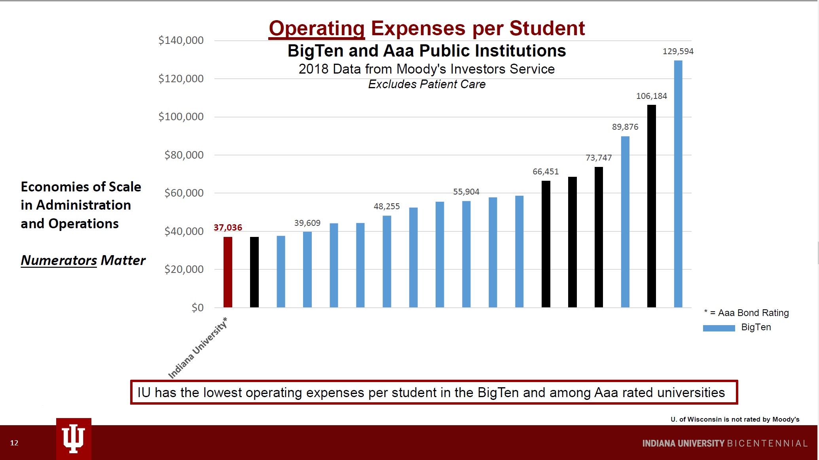
Indiana University
Large – Powerful - Focused
Notes:
Discuss what does Per Student Cost Mean?

Slide 12
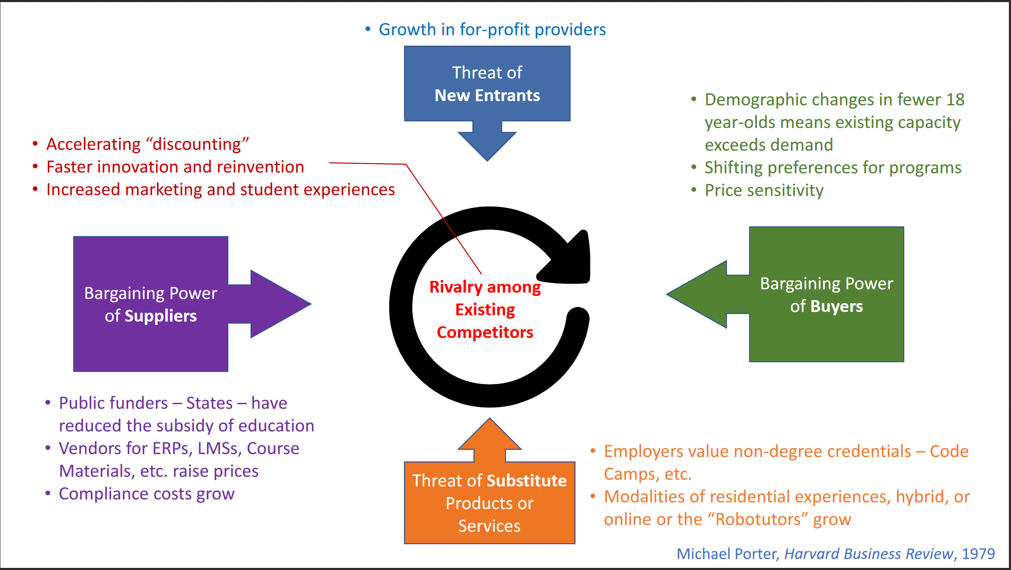
Notes:
Let’s process this together slowly, and clockwise
1st – We've seen the collapse of For-Profit Providers... so moving down
We can look back to our previous slide about changing demographics - Its quite simple, there will be fewer students, and the demand for those students will be higher
If those students look at alternatives to the services, we provide (see the previous slide about the delight of loans)
Also, Code Camps generate interesting employees – Reference Joey
All of us are familiar with switching costs, brings us to big purple, probably not a coincidence that this is the same color as Ellucian (the true great evil)
The panelists made a special point about this – Security & Compliance are infinite costs... And can drown out other growth, ideas or projects all in the name of security. Prompt about “are we using our investment in Microsoft 365 and Azure to cap this spend?”

Slide 13
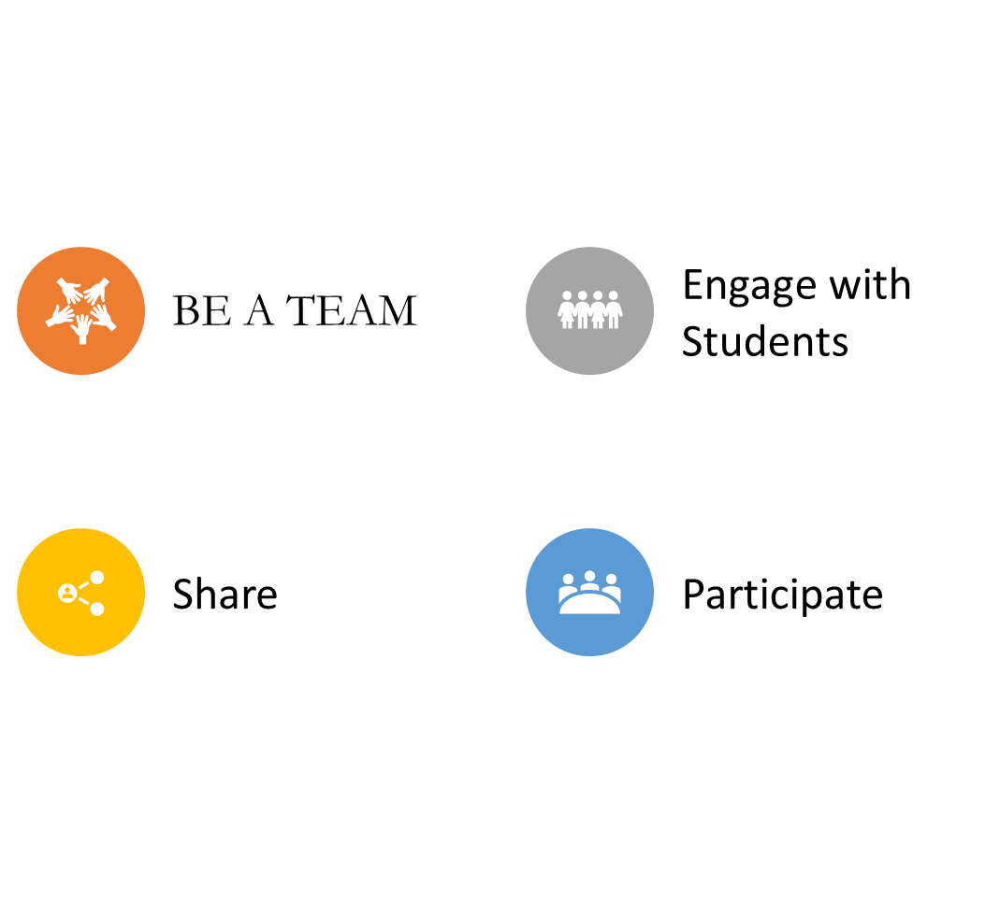
How Do We Respond?
Notes:
Be a Team – Discuss how Teams aren’t just the folks you share in your org, teams are bigger than that, it could be groups of passions (I really like Algebra!)
Engage with Students – Without their feedback we are blind. If you are Changing your own habits, how can you think your customers are not?
Share – None of us are as smart as all of us, sharing your ideas and challenges are critical for better thinking and initiatives. If we are face down in work, we’re not face forward to our students, staff and faculty
Participate – Be engaged in what Western is DOING, Graduation, Ceremonies, Kick offs. Celebrate Place

